Slide 1
DATA SCIENCE PROJECT
ANALYZING FUEL EFFICIENCY

Slide 2
TEAM NAME - CODERS WORLD
TEAM MEMBERS
SAURBH SINGH JAMWAL(TEAM LEADER) : 11701722
VISHESH CHAUDHARY : 11712293
KONDURU BHARATH : 11709175
HARIKIRAN THALLADA : 11702369
SUBMITTED TO : AMITH ASHOKAN

Slide 3
ROLES OF TEAM MEMBERS IN PROJECT
GUI FOR FUEL EFFICIENCY
SAURBH SINGH JAMWAL : DATA FRAME OPERATION,FILTER AND DATA ANALYSIS
VISHESH CHAUDHARY : RESULT ANALYSIS,PRESENTATION AND PLOTTING
DATA VISUALIZATION
KONDURU BHARATH : DATA VISUALIZATION AND DESCRIPTION
HARIKIRAN THALLADA : DATA ANALYSIS AND USING ggplot

Slide 4
PROJECT DESCRIPTION
Entire project is divided into four graphical windows and data visualization using graphs:
GUI
Main window
Car Details
Fuel consumption and journey details
Results
Line Graph shows the value of fuels for different models of different companies.
DATA VISUALIZATION
Using bar graphs
Using pie charts
Using scatter plots
Using line charts

Slide 5
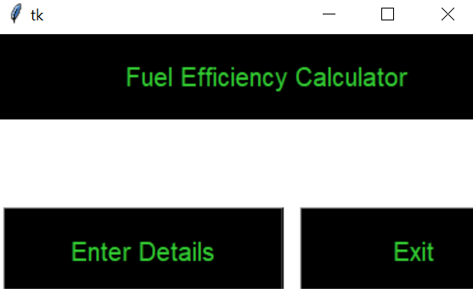
MAIN WINDOW
ENTER DETAILS
It will take the user into the second window and ask for details.
EXIT
It will quit the program

Slide 6
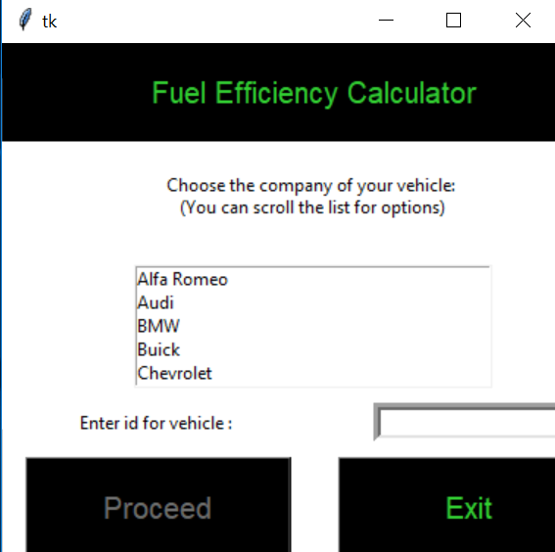
CAR DETAILS WINDOW
Select the company of the vehicle from the list.
Enter the id of your vehicle in the Entry box.
Proceed button will check the input of the entry box and if it is not integer it will pop up message.
You can exit from the program by clicking on exit button.

Slide 7
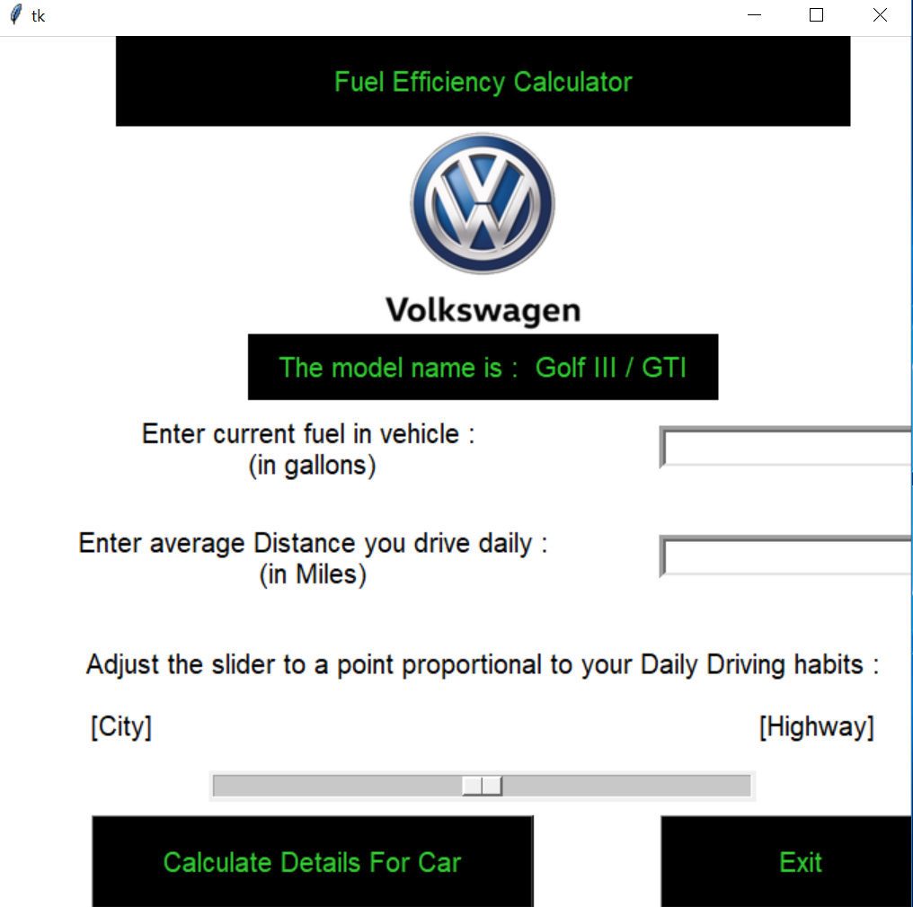
FUEL AND JOURNEY DETAILS WINDOW
Based on details of previous window company logo and model will be displayed.
Current fuel and average distance will e entered by the user.
A slider is provided to the user to enter the ratio of city vs highway journey.
Calculate car details button will take us to result page.

Slide 8
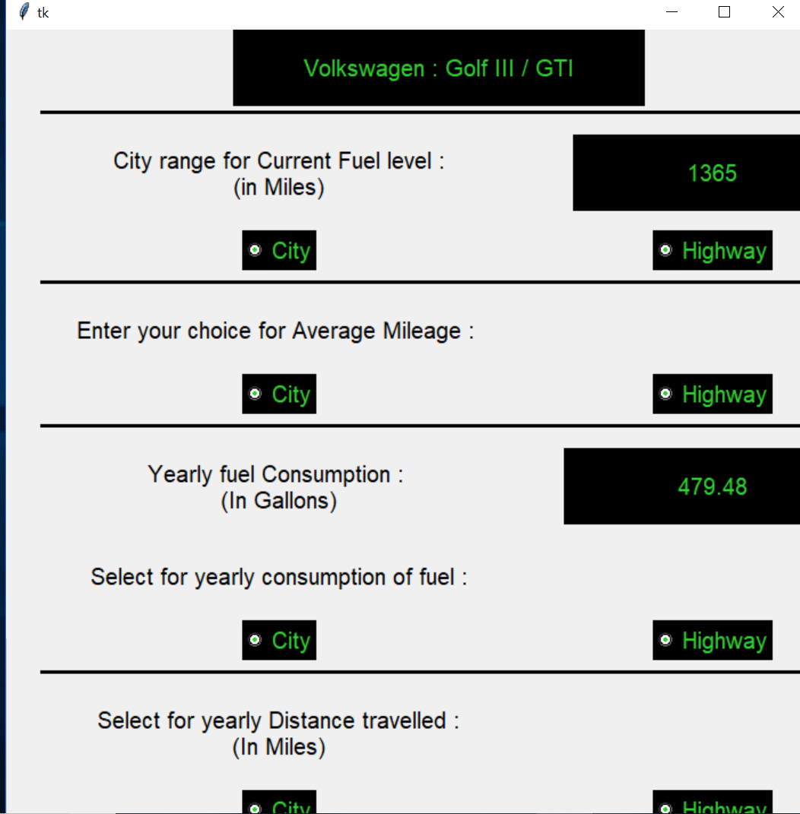
RESULT WINDOW
Range for current fuel will tell how much distance we can go with available fuel.
It will also give the yearly fuel consumption and average mileage of your vehicle
It can also tell the yearly distance travelled by the vehicle.

Slide 9
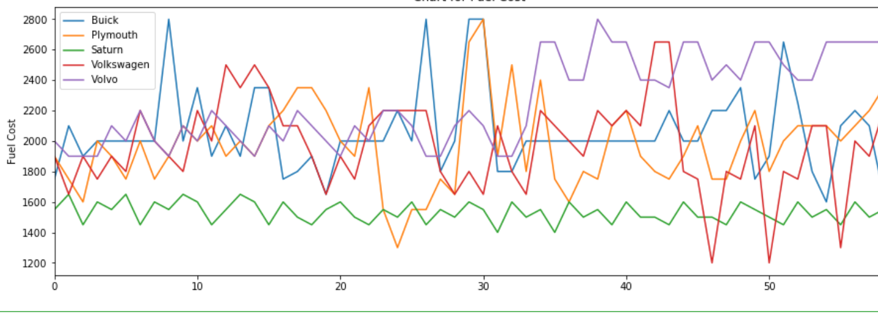
PLOT
This graph shows the variation of fuel cost among different companies.

Slide 10
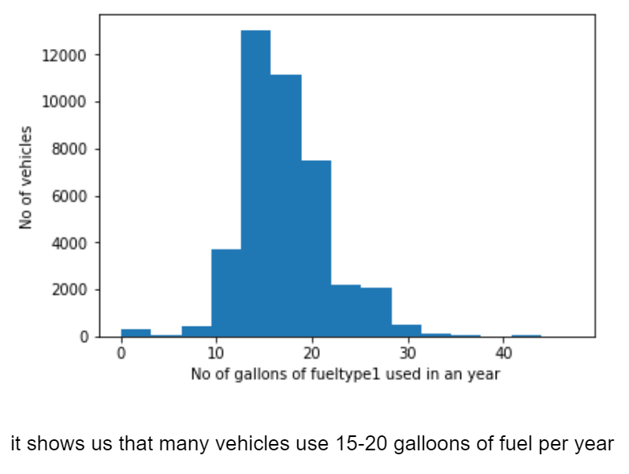
DATA VISUALIZATION USING BAR GRAPH
Number of vehicles using fuel type in different years

Slide 11
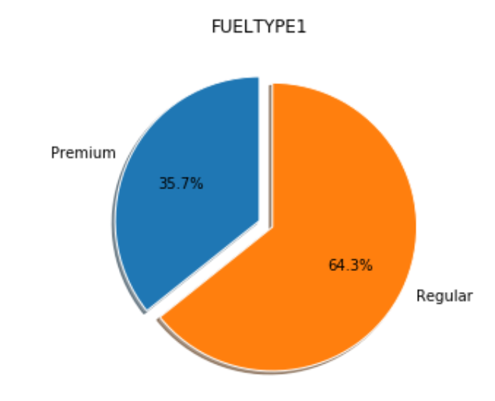
PIE CHART VISUALISING THE USAGE OF DIFFERENT QUALITY OF FUEL1

Slide 12
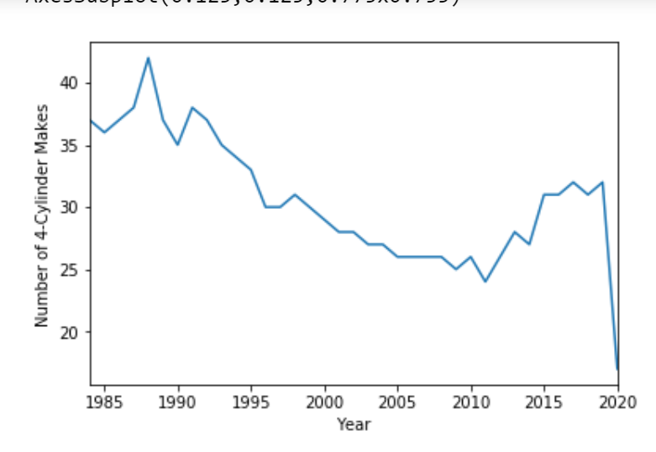
LINE CHART
Showing variation of 4 cylinder makers over the years

Slide 13
LEARNING OUTCOMES
How to use data and manipulate it to obtain useful information.
How to import data from csv files and use that data for information retrieval.
visualizing plain data using graphs and plots.
working as a team and presenting new ideas for implementation.

